Slide 1
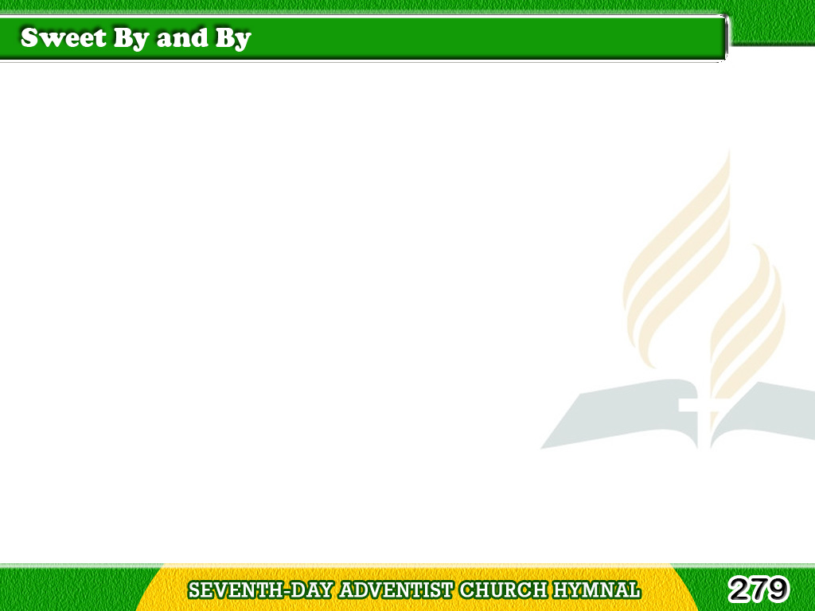
1/3
There’s a land
that is fairer than day,
And by faith
we can see it afar;
Tagalog
Version

Slide 2
1/3
For the Father
waits over the way,
To prepare us
a dwelling place there.
Tagalog
Version

Slide 3
1/3
Chorus
In the sweet by and by,
We shall meet
on that beautiful shore. (2X)
Tagalog
Version

Slide 4
2/3
We shall sing
on that beautiful shore
The melodious song
of the blest,
Tagalog
Version

Slide 5
2/3
And our spirits
shall sorrow no more,
Not a sigh
for the blessing of rest.
Tagalog
Version

Slide 6
2/3
Chorus
In the sweet by and by,
We shall meet
on that beautiful shore. (2X)
Tagalog
Version

Slide 7
3/3
To our bountiful Father above,
We will offer a tribute of praise,
For the glorious gift of His love,
And the blessing
that hallow our days.
Tagalog
Version

Slide 8
3/3
Chorus
In the sweet by and by,
We shall meet
on that beautiful shore. (2X)
Tagalog
Version

